Slide 1






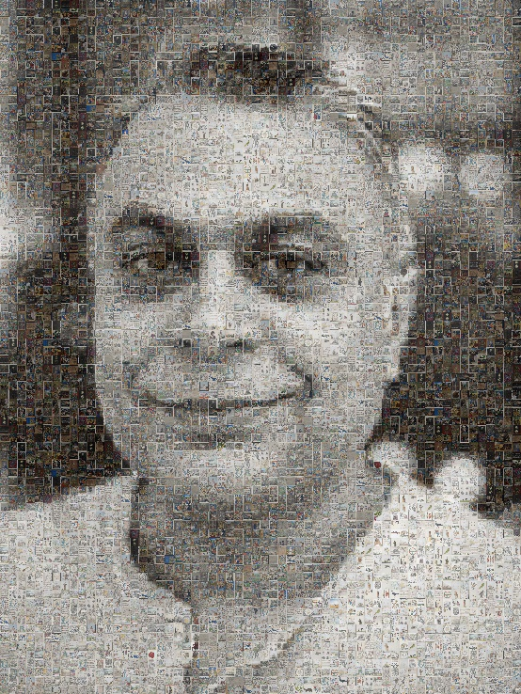
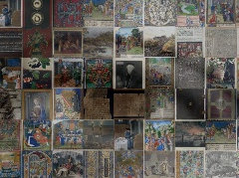
Mr Mahendra Mahey
Lessons we can Learn from Tracing the Reuse of Digital Cultural Heritage Objects
1430-1630, Thursday 2 July, 2026, Institute of Mathematics (IMI-BAS), Sofia, Bulgaria
PhD Candidate (2024-2027) - Information Science Research Group – University of Strathclyde
Research Data Analyst in Humanities - Tallinn University
Researcher - Estonian Research and Cultural Data Infrastructure Project
Researcher - Estonian National Museum, Tartu, Estonia
https://orcid.org/0000-0001-7608-6152
We are our history!
Image made up of
500 digital heritage images
Practices of Open and Responsible Research in the Academic Lifecycle:
Opportunities for Including Altmetrics in Research Assessment
Part of the Pilot programme on increasing the capacity in open science funded by the Ministry of Education and Science in Bulgaria
My work at the Estonian National Museum is supported by the Estonian Ministry of Culture's research and development program “Estonian Culture Research and Development Programme 2023-2026” under grant KUM-TA 43 “Digital Cultural Heritage as a Societal Resource”
mahendra.mahey@strath.ac.uk

Slide 2
http://tiny.cc/GLAM-Labs-Sofia-2-7-26

Slide 3
Overview
About me
Can we easily trace reuse of digital cultural heritage objects?
A new reuse schema for digital cultural heritage?
Q and A

Slide 4
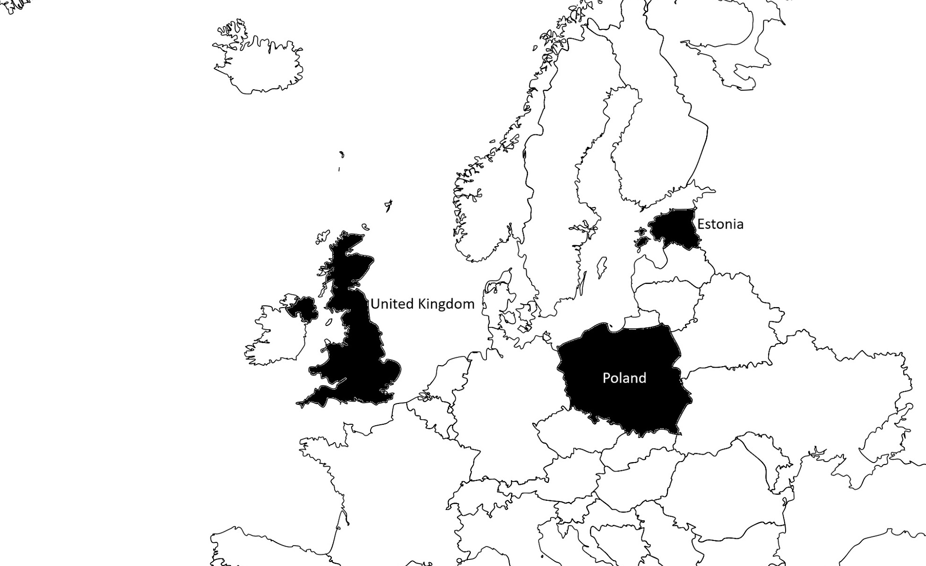













Over 35 years of professional experience in Education and Cultural Heritage
Schools | Colleges | Universities | Libraries | Museums

Slide 5
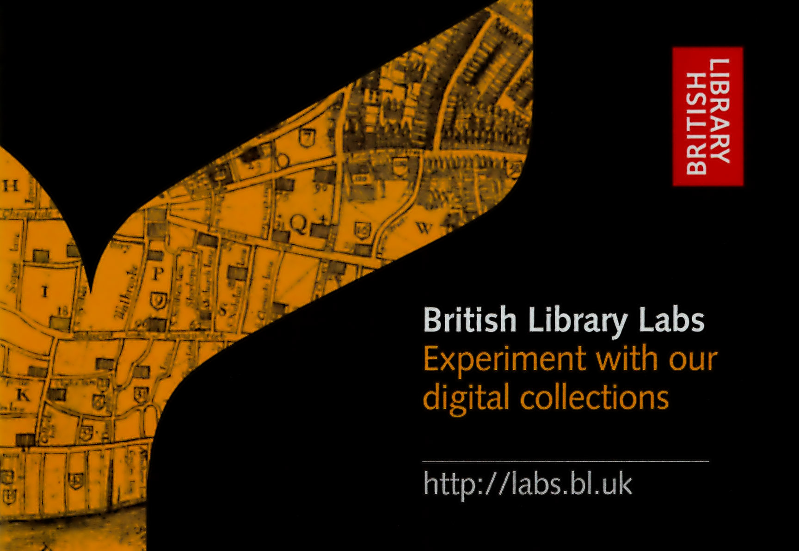

Ran BL Labs from 2012 - 2021
Supported and showcased over 300 projects with researchers, artists, entrepreneurs, educators and British Library staff
Competitions, Awards, Projects and hundreds of conversations
Positioning around using cultural heritage data in data science and Higher Education
Building global community of Galleries, Libraries, Archives and Museums (GLAM) Labs
Funded by the British Library and previously by the Andrew W. Mellon Foundation

Slide 6
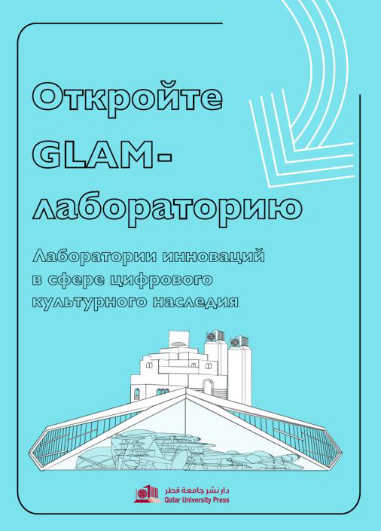
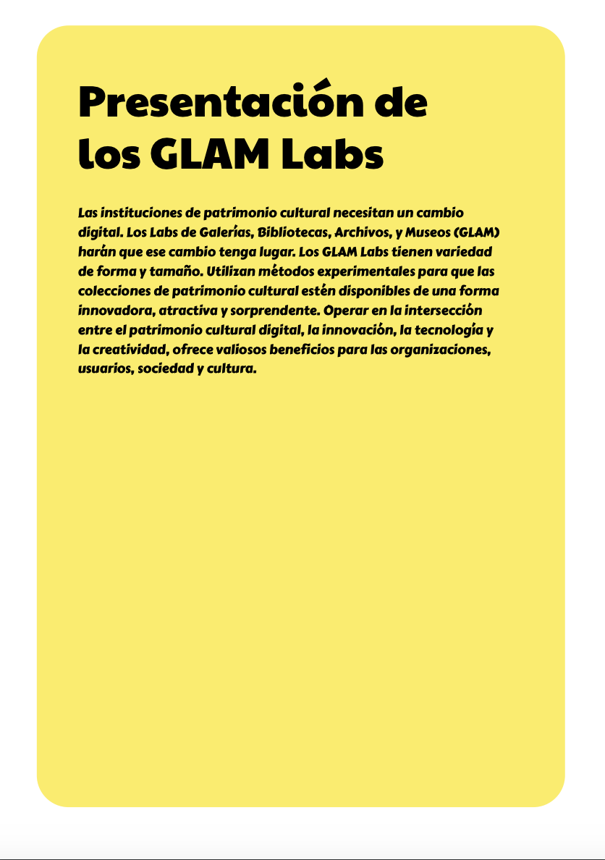
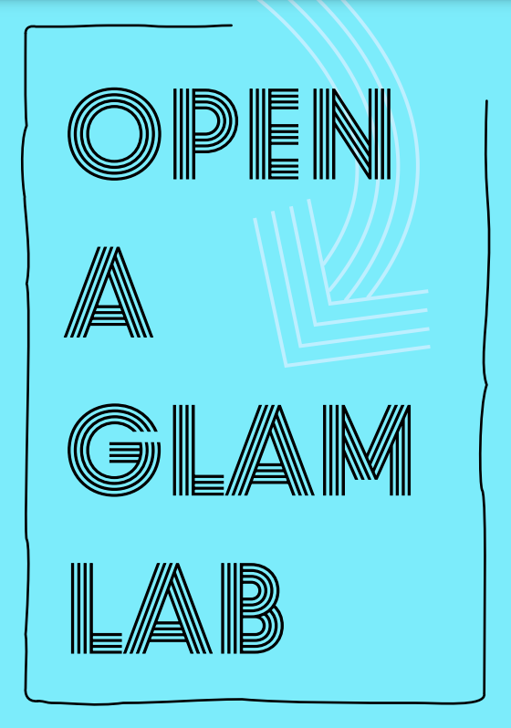
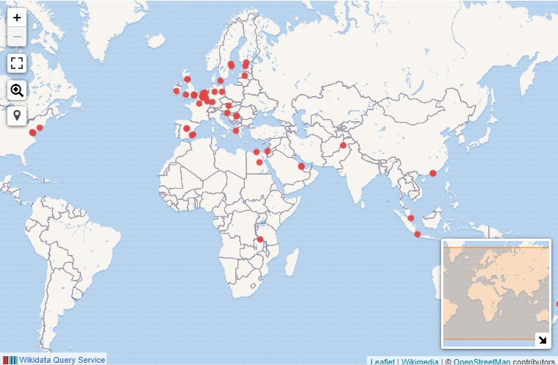
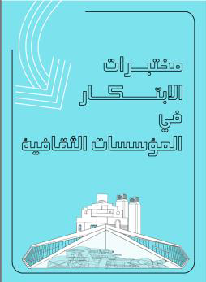
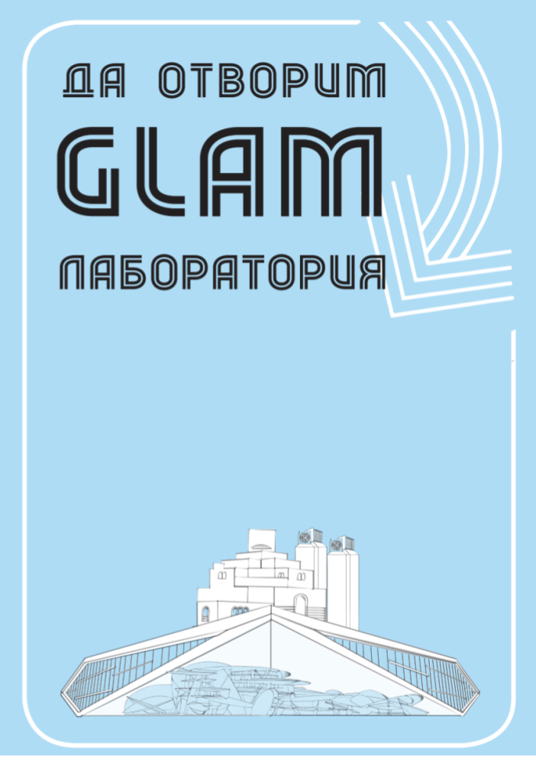
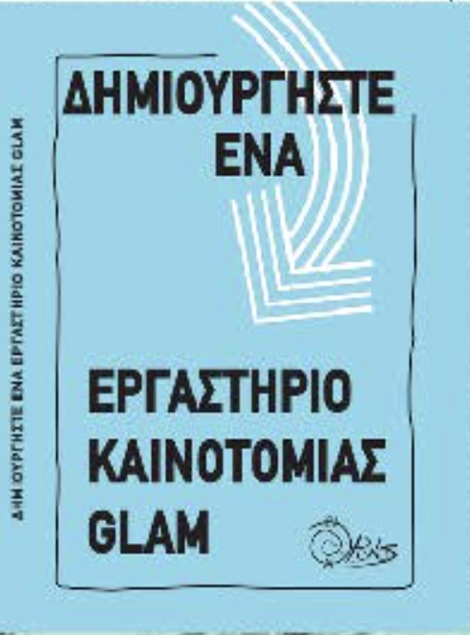
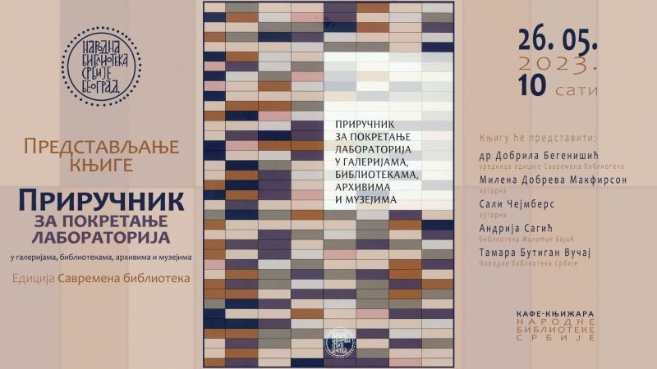
Global GLAM Labs Community
Founded in 2018
2020: RUSSIAN
2020: SPANISH
2021: ARABIC
2021: BULGARIAN
Over 400+ members from 65+ countries
2019: ENGLISH
2022: GREEK
2023: SERBIAN
Mahey, M., Al-Abdulla, A., Ames, S., Bray, P., Candela, G., Chambers, S., Derven, C., Dobreva-McPherson, M., Gasser, K., Karner, S., Kokegei, K., Laursen, D., Potter, A., Straube, A., Wagner, S-C. and Wilms, L. with forewords by: Al-Emadi, T. A., Broady-Preston, J., Landry, P. and Papaioannou, G. (2019) Open a GLAM Lab. Digital Cultural Heritage Innovation Labs, Book Sprint, Doha, Qatar, 23-27 September 2019.

Slide 7
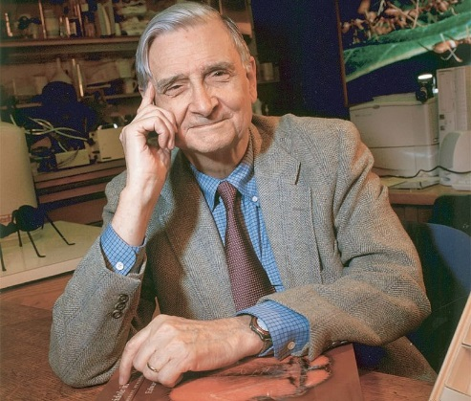
Understanding a person and humanity is hard …
We have Palaeolithic emotions;
some of us work in medieval institutions;
and yet we have been given god-like technology
e.g. computing and internet
Adapted from interview with Sociobiologist
Edward Osborne Wilson - 2009

Slide 8
audience and digital collections
audience interests
digital collections
Often small in proportion
to physical collections
4%* at the British Library!
180* million physical items
Only 9% books
‘Sweet spot’
Hard intellectual engagement sometimes required given
the smaller size & sometimes ‘random nature’ of digital collections
when compared to the physical collections
*estimate

Slide 9
The biased mysterious story of the digital collection… and ALL collections, get to know the story of the collection
Still there?
Curator
Is there any background documentation?
Old format not supported
Who paid for the digitisation?
Published
What media was the
digitisation done from?
Unpublished
Digital
Collection
Who did the digitisation?
Technology used
Where is it?
Access / API?
Born digital?
Can it still be accessed?
Politics when digitised, e.g. Brexit?
Generates income
No Descriptive information
Reputational risk in using?
Descriptive information
Personalities involved
Inconsistent descriptive information
Legalities /
Ethics / Morality
Surprises (e.g. gaps)
Good to know the background ‘story’ and biases of a digital collection
if you want to use it for projects …

Slide 10
Example phases of interaction / engagement with digital heritage in the GLAM Lab
Have a ‘date’
with the ‘data’
Next steps
Publish reuse
Rethink
Iterate
Phase 1
Data Journey
Phase 2
Query-Focussed
Phase 3
Hard deadline
Constrained resources
Ideas change, once people explore the data and perhaps the culture of the institution!
Use computational methods only where appropriate
Well informed question
once you have seen the collection
Incubation idea
to get support

Slide 11
Publish openly – users are NOT obliged to capture reuse…
You could provide form to complete before or after access
  Text to encourage to tell the organisation
  Good ideas but also barriers to use
  Rarely done and questionable rationale
  Poor use
But let’s tap into other human motivations

Slide 12
Altmetrics – evidence of attention but need more to find out actual use
Can show visibility but the quality of interaction is not a given
Can be cited but can it tell us how it used?
Is open but what is the use / impact?
All metrics are ‘whispers’ but not absolute

Slide 13
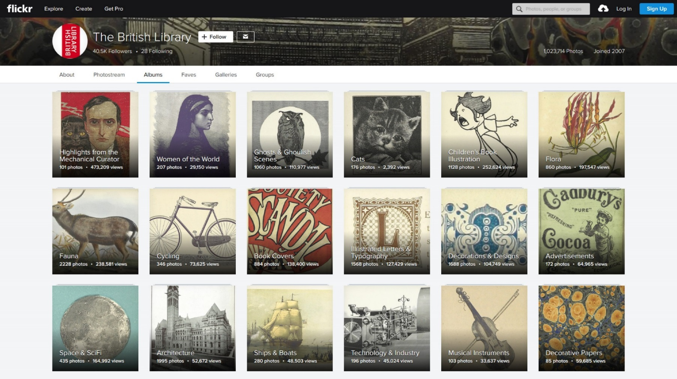
British Library Flickr Commons
Can be effective way to provide access and stimulate engagement with your digital collections (also FREE!)
Since Dec 2013
All public domain, >18 million tags
Over 4 billion views
https://www.flickr.com/photos/britishlibrary/
Join:
https://www.flickr.com/commons/register/
Use other platforms such as Wikimedia Commons, Wikidata, Internet Archive etc.
1 million images from
scanned books

Slide 14
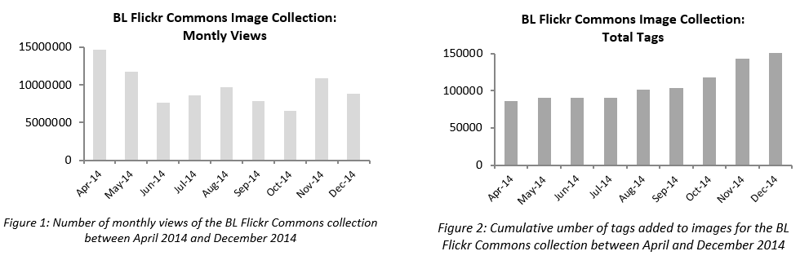
Measures clearly show ‘something’ is happening
Research is vital, long may it live!

Slide 15
Capture stories of reuse
Lock into human nature and motivations
We don’t always publish reuse stories, where is the incentive (especially failures)?
One route is publication
What about other methods?

Slide 16
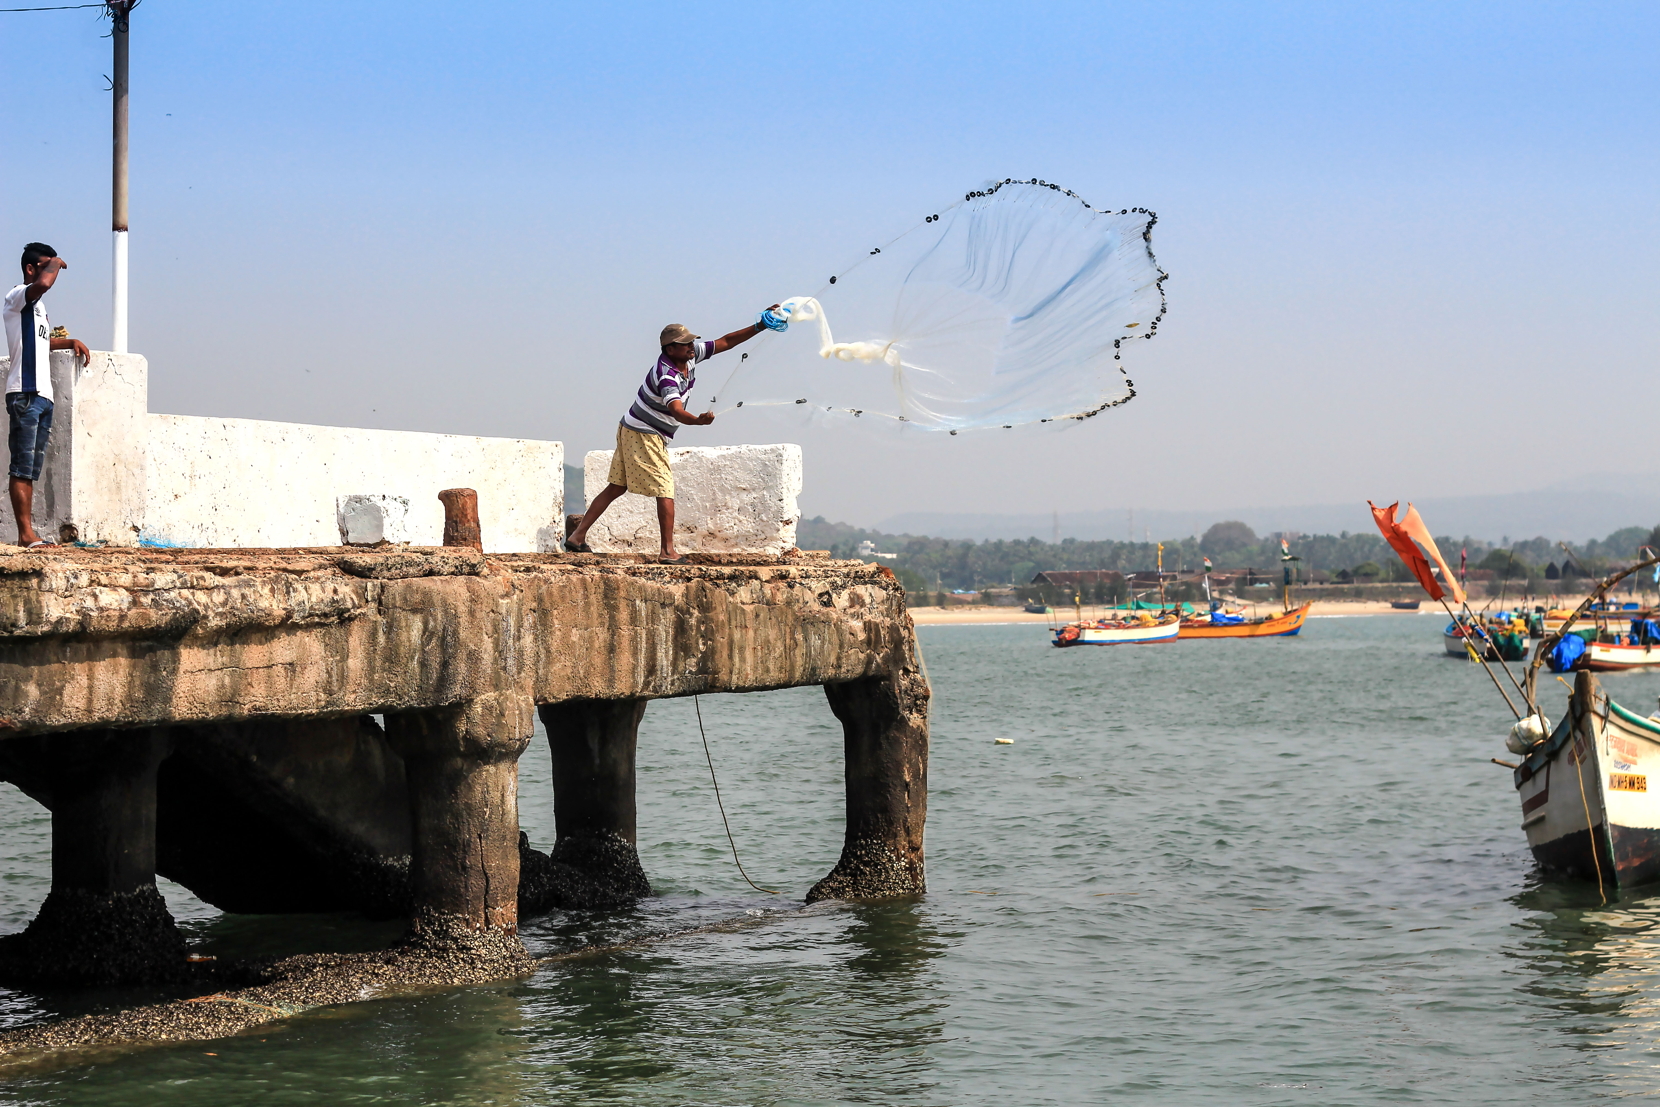
Finding ‘reuse’ can be like fishing in the sea
https://upload.wikimedia.org/wikipedia/commons/c/c5/Fisherman_throwing_the_net_in_the_Arabian_sea.jpg

Slide 17
Through a GLAM Lab
Publication is a motivation
If you tell me story (and are willing to share) you might get an award of actual reuse
Motivation – are researchers more likely to do this?
Does it work?

Slide 18
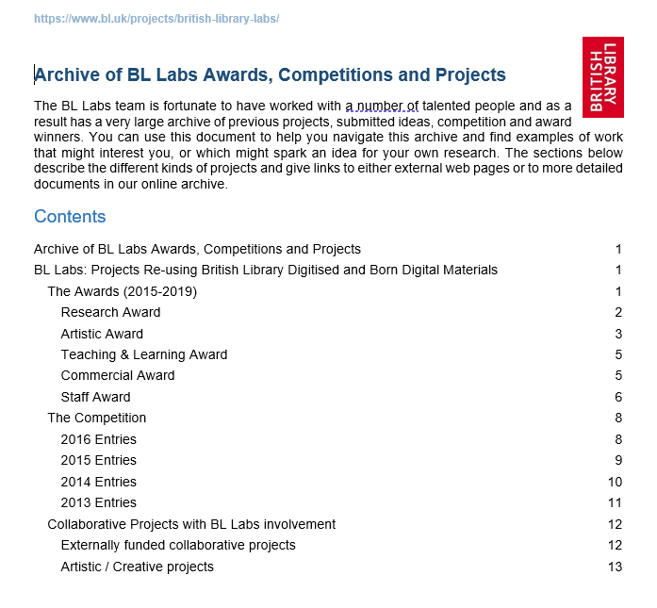
BL Labs Digital Project Archive
Over 300 projects
Examples of reuse
Captured through asking and reward system
Probably drop in ocean
Also used to demonstrate impact
Get more funding
Generate new ideas for reuse at workshops

Slide 19
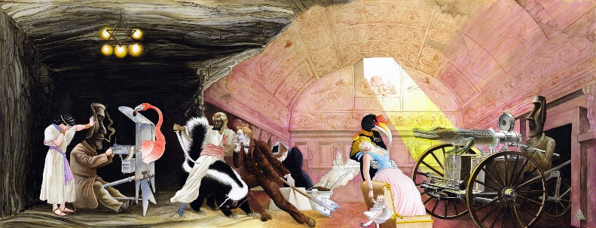
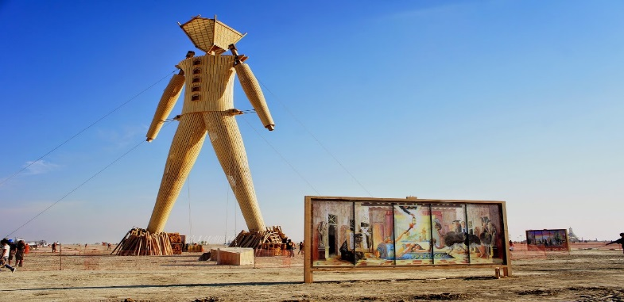
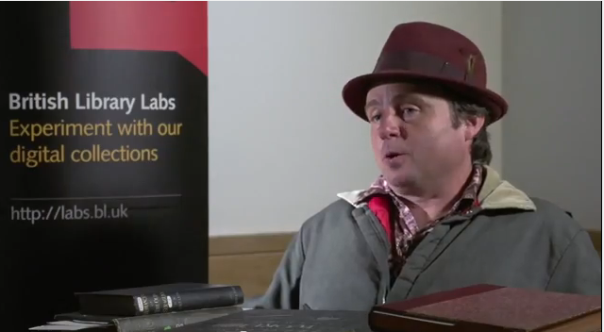
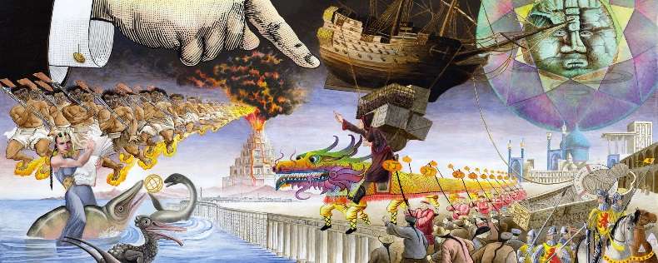
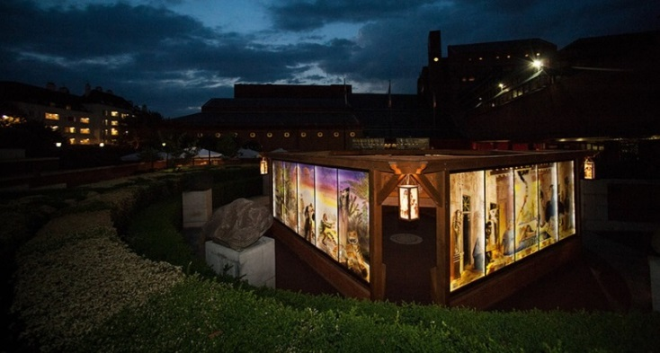
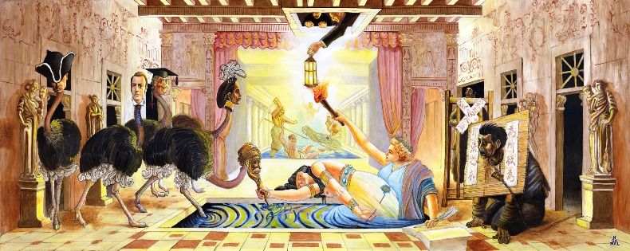
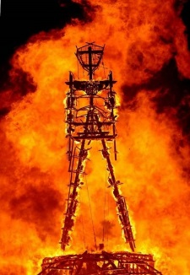
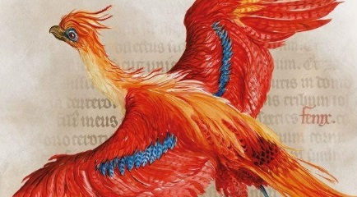
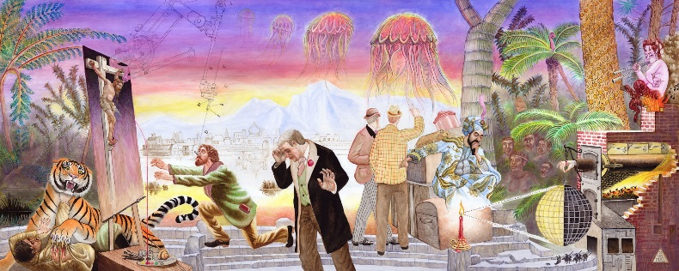
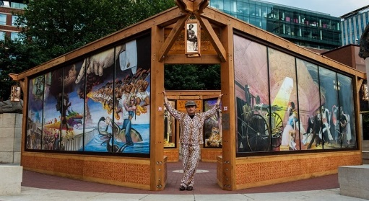

David Normal – Artist
Crossroads of Curiosity –
Collage Paintings
Crossroads of Curiosity @ Burning Man 2014
https://youtu.be/Q3SBxO34Zlc
‘It was beyond my wildest dreams’
Crossroads of Curiosity @ British Library 2015
1 million images from scanned books
https://www.crossroadsofcuriosity.org/

Slide 20
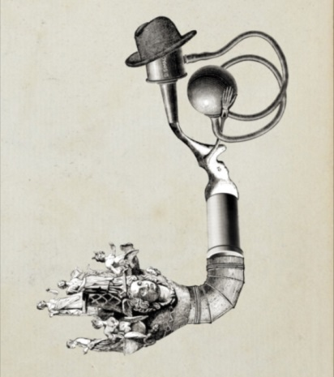
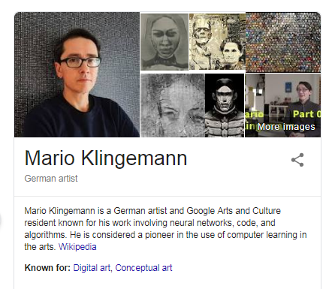
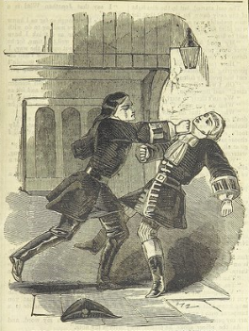
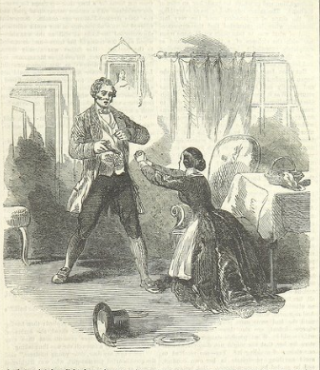
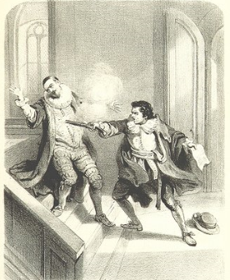
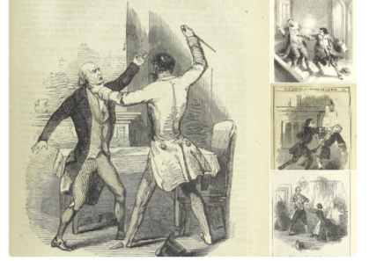
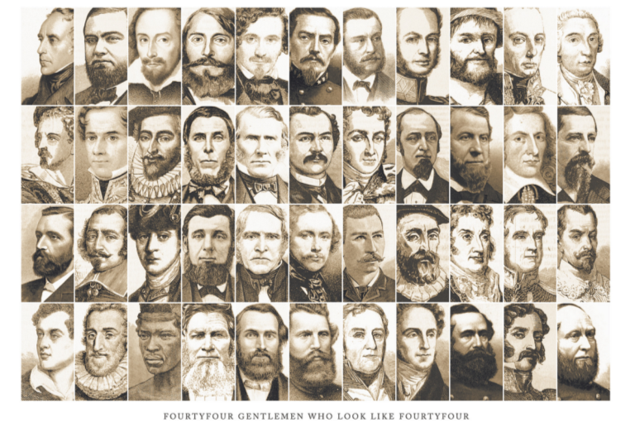
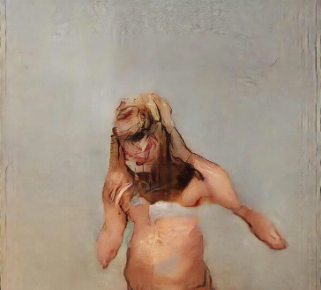
Mario Klingemann – Code Artist
First Artistic Award winner!
http://quasimondo.com/
http://goo.gl/dM8ieA
The Butcher’s Son
2018 LUMEN Prize winner
https://lumenprize.com/a-i-portrait-scoops-gold/
44 Men who Look 44
(Notice the direction faces)
A Hat on the ground
spells trouble

Slide 21
Documenting and publishing impact of GLAM Digital Cultural Heritage
GLAMs need to be better at systematically measuring impact of their reuse of digital cultural heritage
GLAMs don’t always document reuse of their digital cultural heritage, don’t always see the value, rely on proxy metrics such as views and downloads, but that does not say much about impact, they don’t tend to publish these accounts often
There are several schemes to help out such as excellent D-Craft and inDICEs examines social impact
Collections as Data and Datasheets for Cultural Heritage enable more systematic publication of digital cultural heritage, and make it machine accessible.
Me and colleagues are developing an approach to document reuse of digital cultural heritage to allow comparisons for better planning for digital cultural heritage projects

Slide 22
Creating a new schema to measure reuse?
There is currently not a schema developed to document reuse and impact of digital cultural heritage

Slide 23
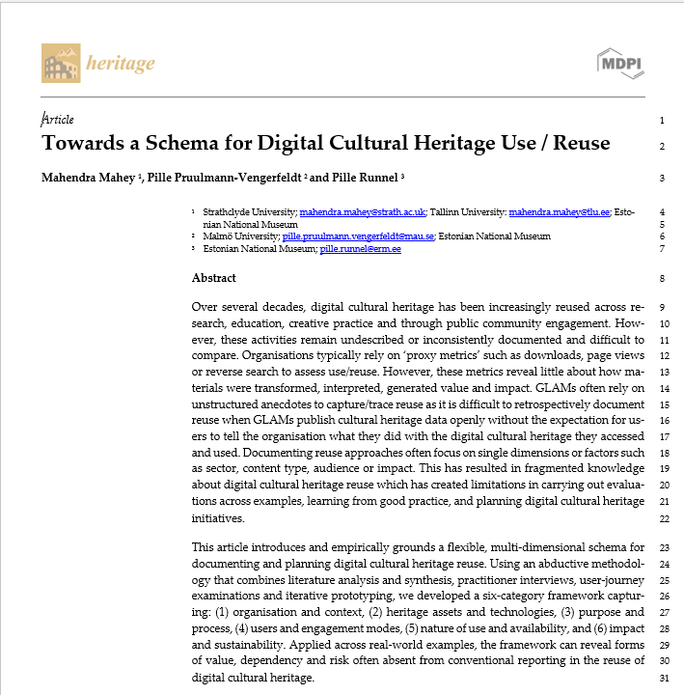
Towards a Schema for Digital Cultural Heritage Use / Reuse
Article submitted to Heritage Journal Special Issue
By Mahendra Mahey, Pille Pruulmann-Vengerfeldt (Malmo University) and Pille Runnel (Estonian National Museum)

Slide 24
Methodology
Abductive research design
Literature synthesis on reuse, impact and metadata frameworks
132 reuse examples and 11 user journeys analysed
67 practitioner interviews conducted
Iterative prototyping and validation of framework.

Slide 25
Six Category Framework
1. Organisation & Context
2. Heritage Assets & Technologies
3. Purpose & Process
4. Users & Engagement
5. Nature of Use & Availability
6. Impact & Sustainability

Slide 26
Six Category Framework
Category | Core Questions | What it captures | Example indicators | Why it matters
7 Pre-questions 1. Organisation & Context 6 Questions | Where and under what conditions does reuse occur? | Institution type, funding, resources, skills | GLAM lab, grant-funded, team roles | Explains capacity, constraints, and sustainability
2. Heritage Assets & Technologies 6 Questions | What materials and tools enable reuse? | Data types, formats, Application Programming Interfaces (APIs), platforms, processing | Images, metadata, Machine Learning tools | Shapes what forms of reuse are technically possible
3. Purpose & Process 11 Questions | Why and how is reuse undertaken? | Aims, activities, workflows, motivations | Teaching, remix, analysis | Connects intentions to practices and outcomes
4. Users & Engagement 8 questions | Who participates and how? | Audiences, literacy, interaction modes | Co-creation, viewing, crowdsourcing | Reveals pathways to meaning making and access barriers
5. Nature of Use & Availability 9 Questions | What constraints shape reuse? | Licensing, openness, persistence, access | CC-BY, temporary exhibit | Determines reach, equity and longevity of reuse
6. Impact & Sustainability 8 Questions | What value and longevity result? | Outcomes, beneficiaries, maintenance | Learning, identity, ongoing support | Supports evaluation beyond proxy metrics
50 Questions in total between 30-60 minutes complete

Slide 27
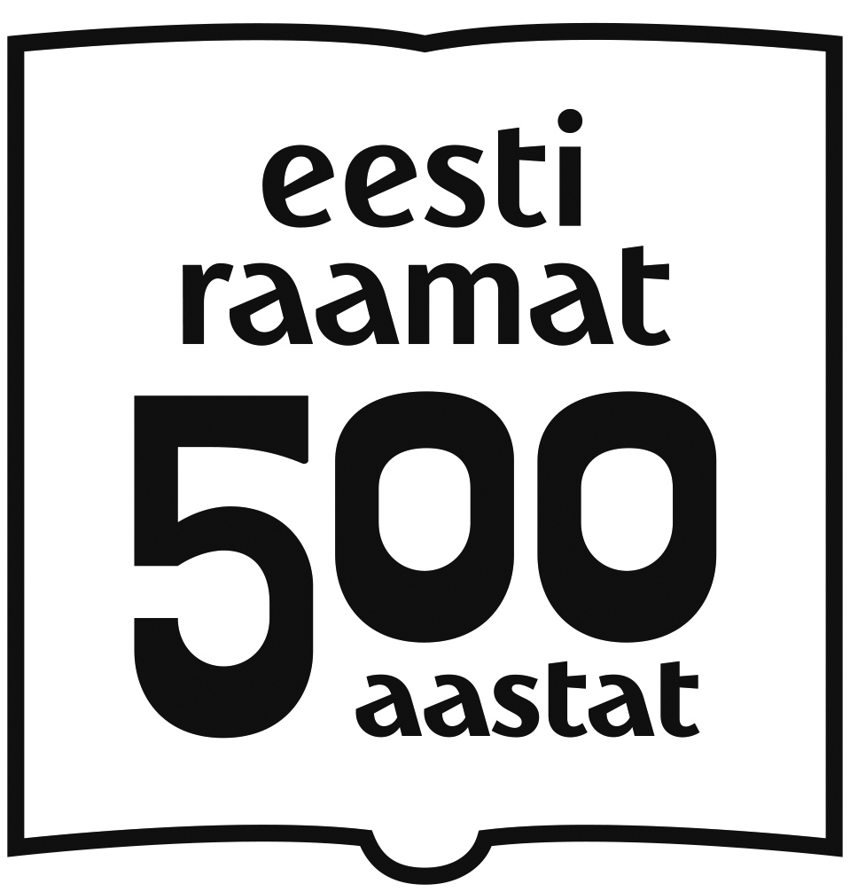
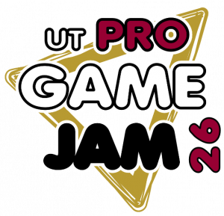
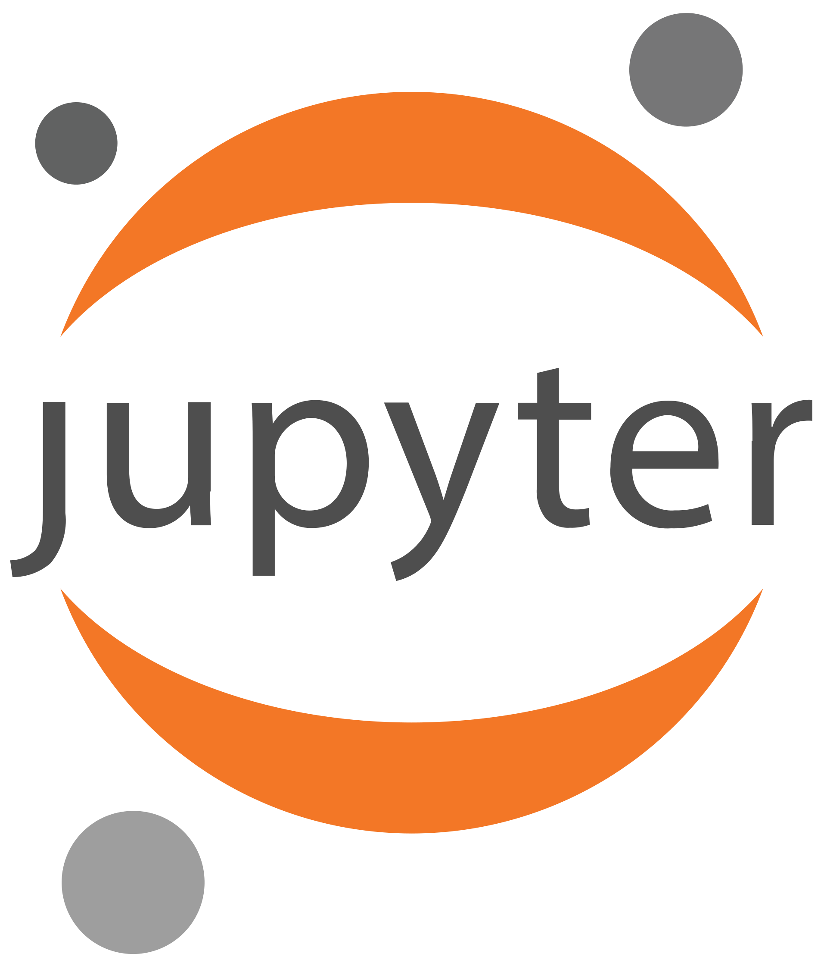
3 Illustrative Case Studies
https://www.erm.ee/et/raamat500
Estonian Book 500 competition – creative heritage storytelling.
Pro Game Jam – participatory game development using museum data.
Jupyter Notebooks – computational reuse of heritage datasets.
Framework enabled cross-case comparison and identification of dependencies.
https://cs.ut.ee/et/sisu/mangujamm-university-tartu-pro-game-jam-2026
https://github.com/hibernator11

Slide 28
Altmetrics – need to assess using qualitative approaches
Contribute to understanding reuse
Raft of measures to examine attention, impact, FAIR, Open Science, etc indicate ‘something is happening’
Also need qualitative approach to dig deeper to actual reuse…

Slide 29
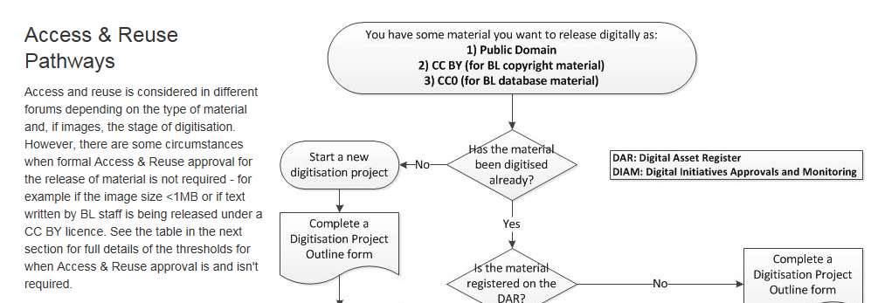
Uses of Schema
Planning tool
Build examples of use
Used to attempt to populate metadata or make suggestions for digital cultural heritage before publishing
Examples of use, direct links for example.
Policies and processes for digital re-use are critical
Others…

Slide 30
Key Findings & Conclusions
Reuse is a socio-technical process, not simply access to data and needs to be recorded.
Open licensing, skills support and mediation encourage reuse.
Schema Framework supports evaluation, planning and sustainability.
Documentation can function as infrastructure for cumulative learning and should be living document.
More work needed, early stages, needs adoption.
Could help in planning and publication of new digital cultural heritage datasets

Slide 31
If you are interested, please contact me @
We are our history!
Image made up of
500 digital heritage images
mahendra.mahey@strath.ac.uk

Slide 32
http://tiny.cc/GLAM-Labs-Sofia-2-7-26

